Slide 1
Electronics and Payload

Slide 2
E&P Team Overview
Objective: Develop and test all electronic systems to support the team. Integrate a unique and competitive 10 pound payload.
Progress:
Reselected primary flight computer
Finished design of E&P bay, launch control system, sensor package
Began prototyping, construction and parts ordering
Payload collaboration/integration
Finished (mostly) Riverside engine test facility
Overview
Electronics & Payload

Slide 3
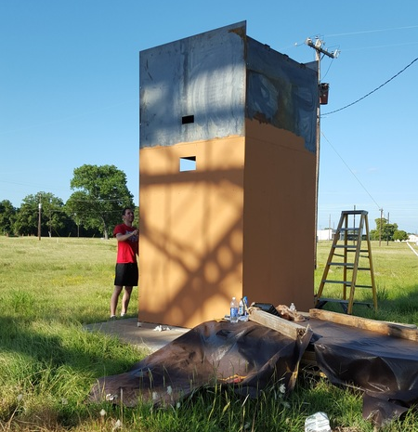
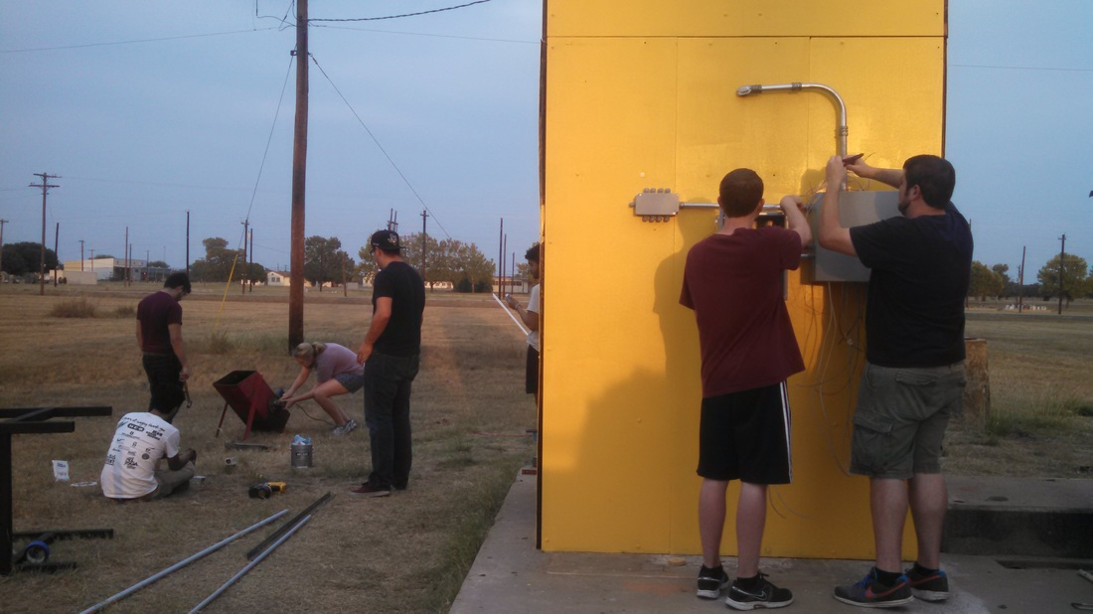
Engine Test Facility
Redesigned/rebuilt from ground up
Completely integrated electrical system
Capable of supporting variety of sensors and controls
Engine Test Stand
Electronics & Payload

Slide 4
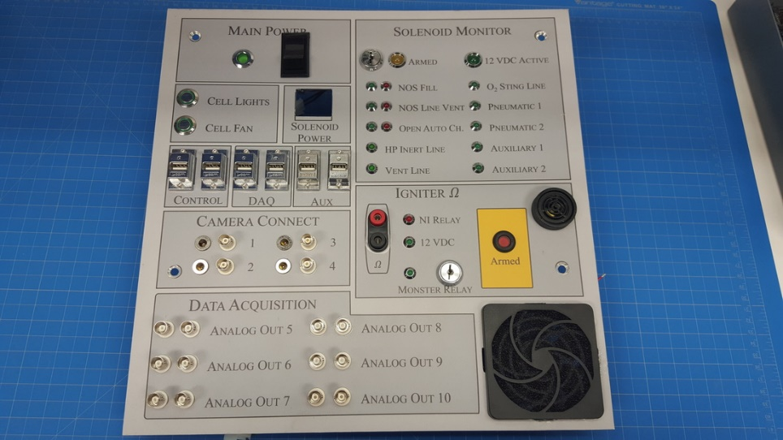
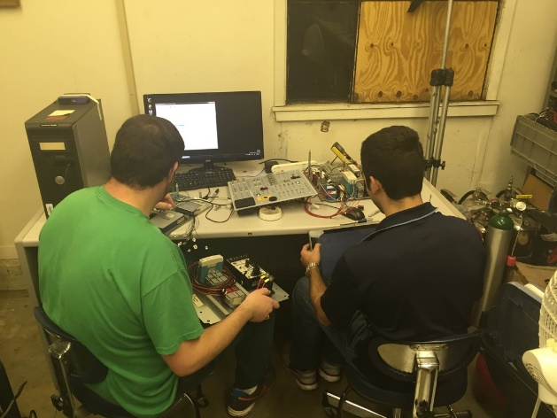
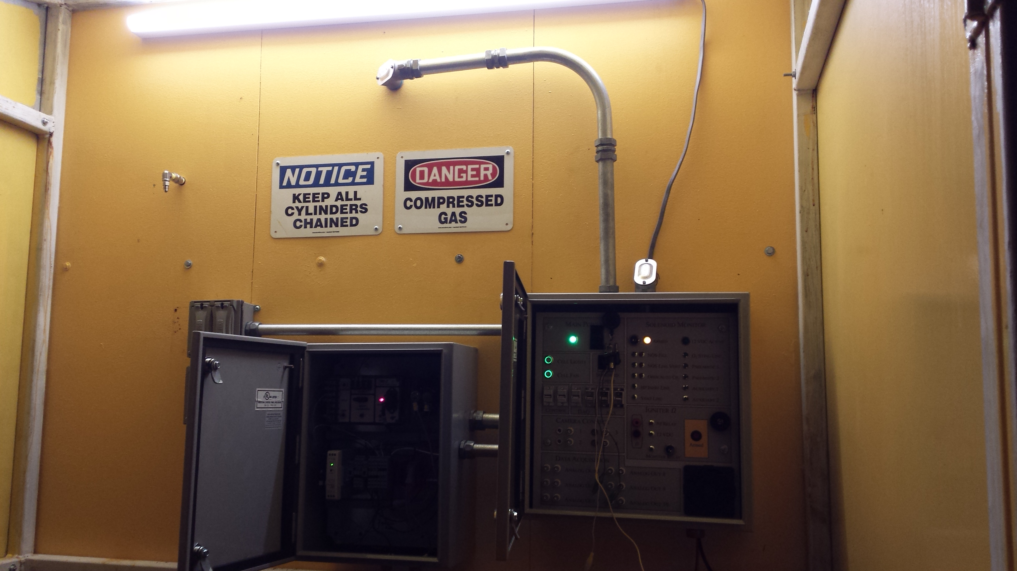
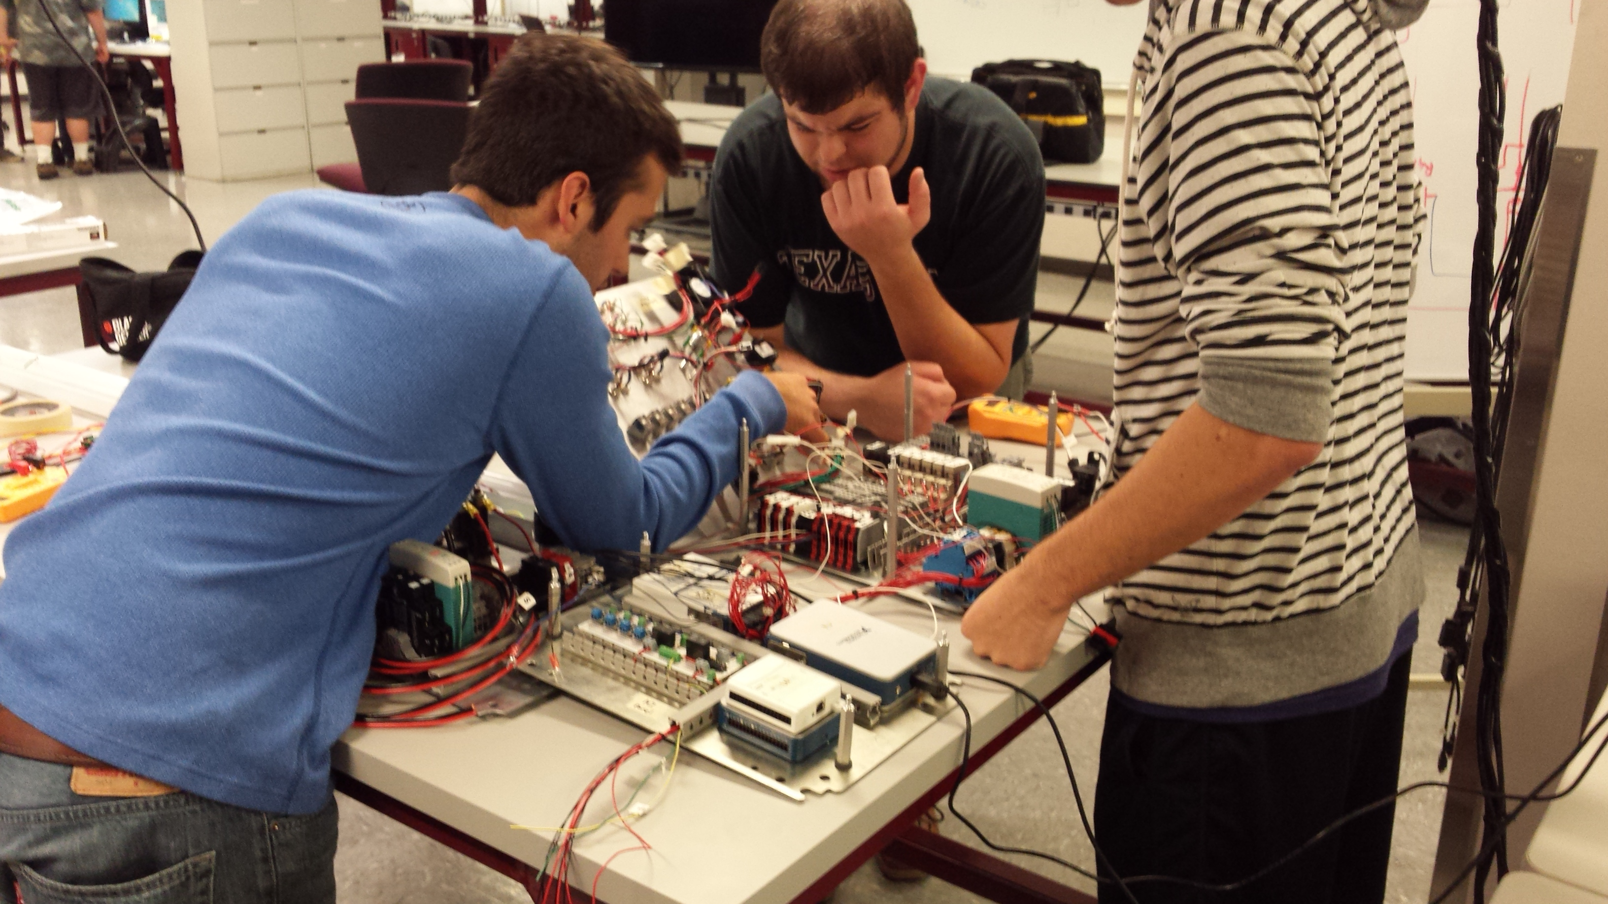
Engine Test Facility
Streamlined engine testing process
Camera feed, live data/control from inside nearby building
Permanently installed DAQ, control circuitry, lighting, etc.
Gas cylinder storage area
Underground power line (401 class; in progress)
Remaining parts/supplies to be ordered then installed (1-2 days work)
Engine Test Stand
Electronics & Payload

Slide 5
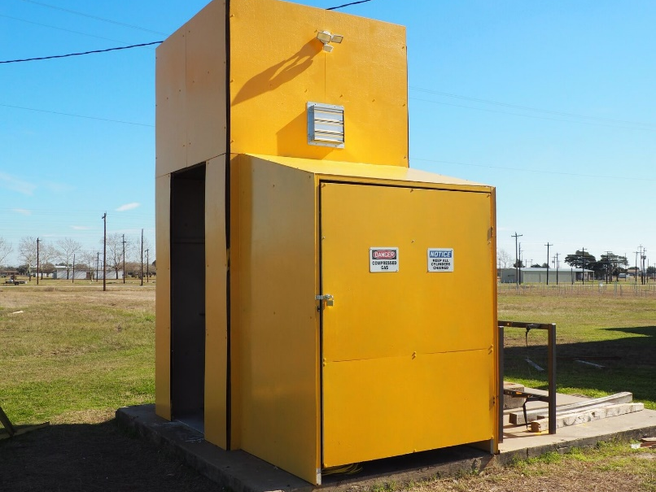

Slide 6
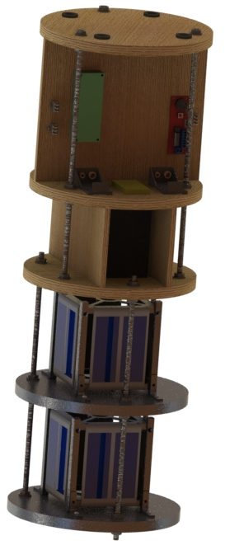
Electronics Overview
Electronics will consist of two similar and connected, but functionally separate bays.
The avionics bay, housing mission critical electronics
The payload bay which doubles as support for the satellites as well as providing extra weight
Payload bay connected to avionics bay below using bolts
Entire system integrated with rockets using U bolts below nose cone
E&P Bay
Electronics & Payload

Slide 7
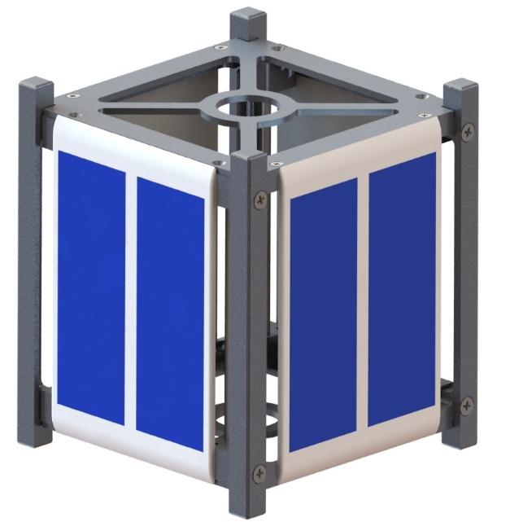
Payload
Rules:
Must be a minimum of ten lbs
Must be of scientific/engineering merit
Cannot interfere with rocket stabilization
CubeSat Payload:
Two teams each developed a 1U cube satellite, based at University of Sydney led by Dr. Xiaofeng Wu
We will be collaborating to “field test” their design, see how it preforms under launch conditions, visiting in the coming months
Bonus creativity and points for international effort on extremely valid engineering payload
Both satellites expected to be around 2.2 lbs. a piece, coming to around 4.5 lbs total
To make up for this weight deficiency, we are creating a payload bay which will house the two satellites as well as provide additional weight.
Payload
Electronics & Payload

Slide 8
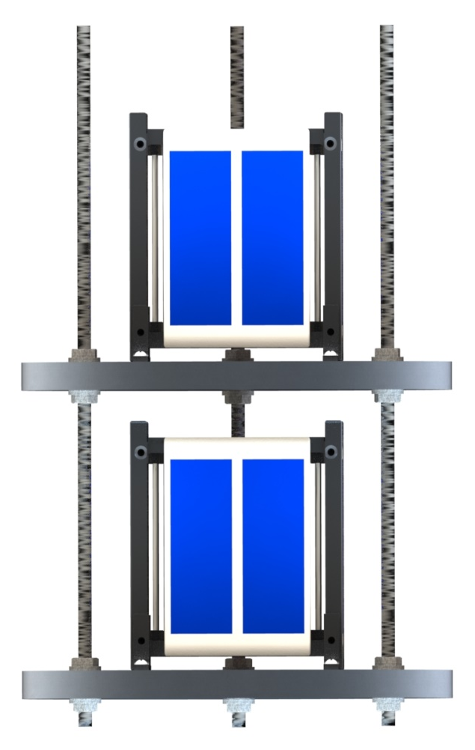
Satellite Bay
Design
Connected to avionics bay at the bottom, creating a full tower
The satellite bay will be two milled pieces of aluminum in place of wood slats to increase weight
Placed horizontally and connected by three all thread bolts and lock nuts like avionics bay
Each satellite placed on a aluminum slat in separate “story”
At free hanging end, we will have padding placed at bottom of chamber to lend lateral direction support during launch jostling
Payload
Electronics & Payload

Slide 9
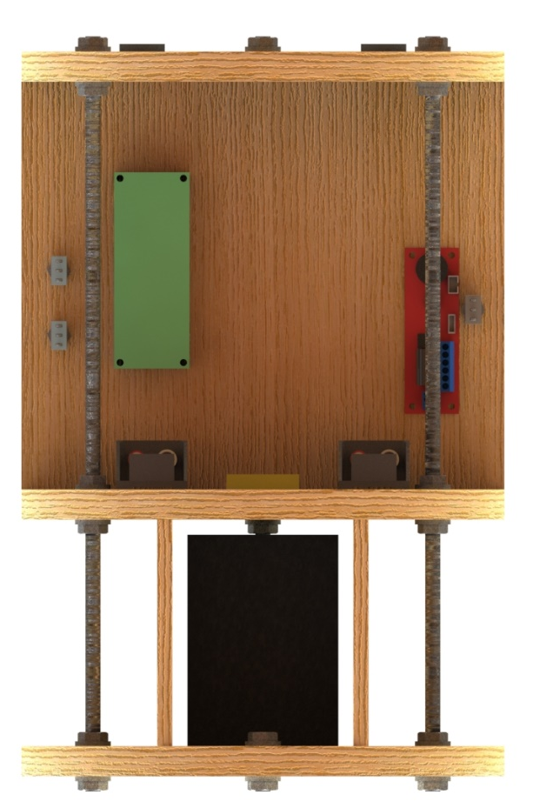
Avionics Mounting
Requirements/Rules
Our goal is to provide a separate and detachable electronics tower, capable of accepting various sensors at different locations, while adhering to competition rules
Design
Avionics tower will be machined out of hard plywood
Three horizontal platforms, creating two sections, bottom for battery, top for primary electronics, holes drilled through platforms for wires
Top section has vertical board for all electronics to be mounted on for single axis mindfulness
Two additional bottom section mounts for additional surface
Three all thread rods, secured with lock nuts at each platform, going all the way through
Connected to rocket body using recovery bulkhead U bolts at top
Electronics Bay
Electronics & Payload

Slide 10
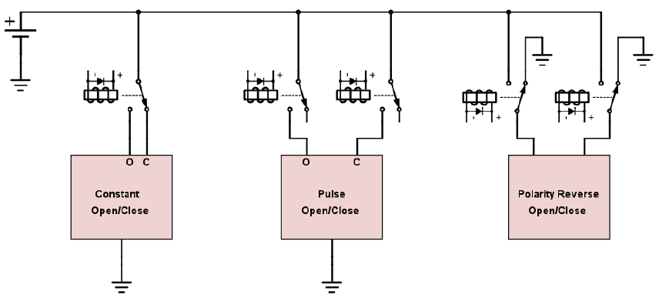
Launch Relay System - Design
Wireless fill and launch control
N₂O fill/vent, O₂ fill, quick disconnect, igniter
Modularity and future SRT use
Solenoid compatibility
Hold o/c, pulse o/c, 12 VDC, 24 VDC
1 or 2 car battery operation
3 extra channels (easily expandable)
Safety
Separate computer power source
Pushbutton 20 mA igniter continuity test
Primary arming key switch and igniter disable switch
Remote control solenoid and igniter arming (with buzzer)
3 Types of Solenoids
Launch Control
Electronics & Payload

Slide 11
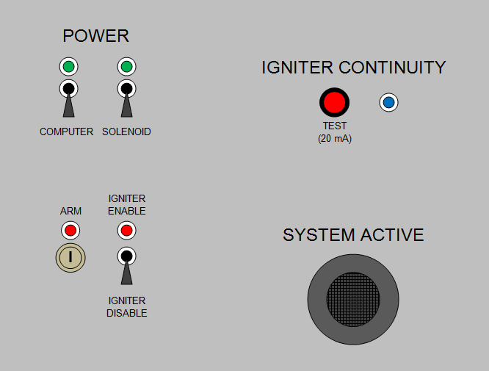
Launch Relay System – Key Components
Container and interface
ABS hinged box
15" L x 11" W x 6” H
Steel mounting plate
Stainless DIN 3 rail
Identical Riverside receptacles
4x car battery clamps
Switching and control
Arduino Mega 2560 R3
16x N-channel MOSFETs
11x SPDT 16 A relays
2x arming relays
100 A igniter relay
Launch Box Interface Panel
Launch Control
Electronics & Payload

Slide 12
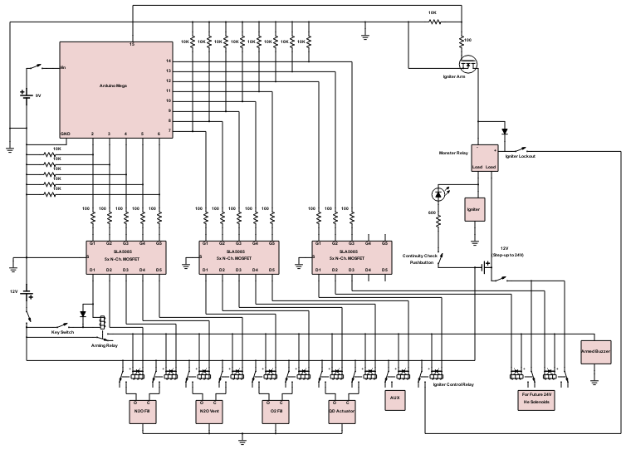
Launch Relay System - Diagram
Arduino Mega
Igniter Arming
MOSFET (-)
9V Battery
(Arduino ~5 hr
supply)
Igniter Relay and
Lockout Switch
5 pack N-Ch
MOSFETs
Continuity Test
12 V Car
Battery
24 V Step-Up
(Car Battery)
Arming Key
Switch and Relay
Warning
Buzzer
16 A Solenoid Relays
(built in flyback diode
and test LED)
24 V Relay
Section
Launch Control
Electronics & Payload

Slide 13
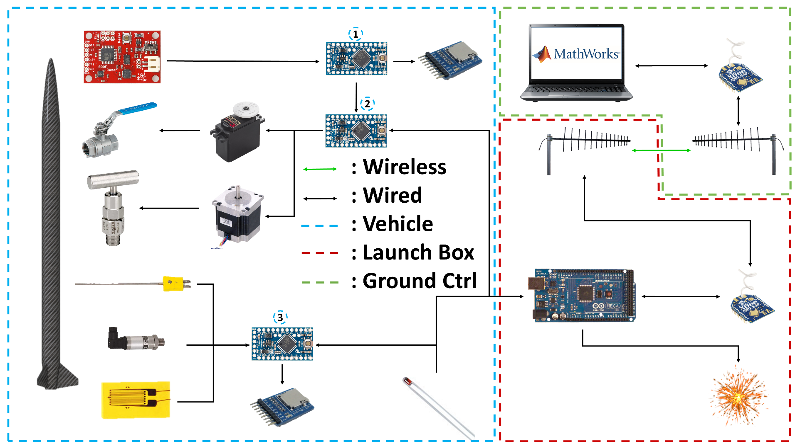
Data & Communication Systems Architecture
Wireless Comm.
Electronics & Payload

Slide 14
Data Transmission
One wireless 900 MHz channel between launch box and launch operations computer
Use launch operations computer to send command to launch box
MathWorks includes support package for Arduino communication
Arduino receives command then sends back that it received command
If Arduino does not acknowledge, we will know to send command again
Arduino sends status update when command is completed
In case of sensors, data collection begins
In case of one-time command, a short message is sent
Wireless Comm.
Electronics & Payload

Slide 15
Sensors
Necessary for testing and flight data collection
Vehicle will contain an IMU, two pressure sensors, and three thermocouples
Data will be read in and processed by Arduino Pro Minis
System very flexible
Allows for additional sensor or microcontrollers
Data stored in 32 GB microSD cards
Flight Sensors
Electronics & Payload

Slide 16
Rocket Safety System
Course deviation failure prevention system
IMU data continually processed to determine if shutdown is appropriate based on vehicle orientation
In event of shutdown, oxidizer’s ball valve is closed and the venting needle valve is opened.
Rocket Safety
Electronics & Payload
Notes:
Data in sensors is inherently “jumpy” so multi-data-point average necessary for useful data
Thorough testing of IMU necessary to test for drift
Speed of ball valve closure greatly determines effectiveness of such measures

Slide 17
Power Requirements
Sensor | Voltage Draw | Current Draw (ea) | Power Draw (ea) | Quantity
Thermocouple | 3.3 V | Negligible | N/A | 3
IMU | 3.3 V | 1.2 mA | 3.96 mW | 1
Strain Gauge | 5 V | 100 mA | 500 mW | 2
Pressure Transducer | 12 V | 10 mA | 120 mW | 2
Arduino Pro Mini | 5 V | 25 mA | 125 mW | 3
Flight Total: | - | 296.2.2 mA | 1.619 W | 11
Will be utilizing last year’s battery
Arduinos require much less power than BeagleBones so have plenty of energy to spare with last years battery
This means any additional sensors added do not cause a concern with regard to power
Power
Electronics & Payload
Notes:
Arduinos are able to output 500 mA each

Slide 18
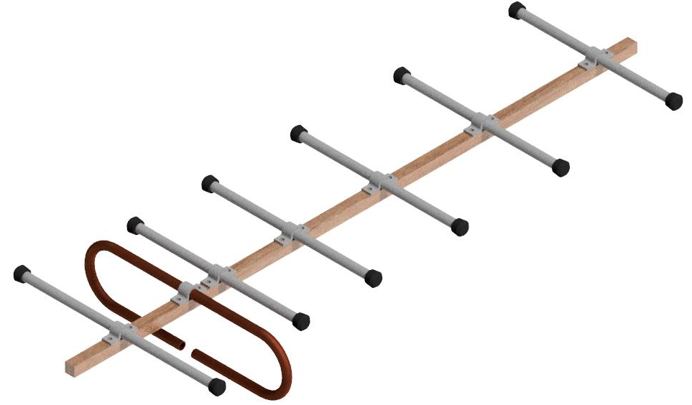
Data Transmission- Antennas
Home built Yagi antennas to gain experience while lowering cost
Prototype currently under construction, commercial antennas will be purchased if prototype proves ineffective
Element spacing and geometry calculated using antenna construction calculator
Driven Element: Folded dipole copper tube, folded by 3D printed tube bender
Frequency: 900 Mhz
Directors: 5
Wavelength: 333 mm
Coax: 50 Ohm
Directors/Reflector: Aluminum tube
Insulated wooden boom
Elevation: 7+ feet
Wireless comm.
Electronics & Payload

Slide 19
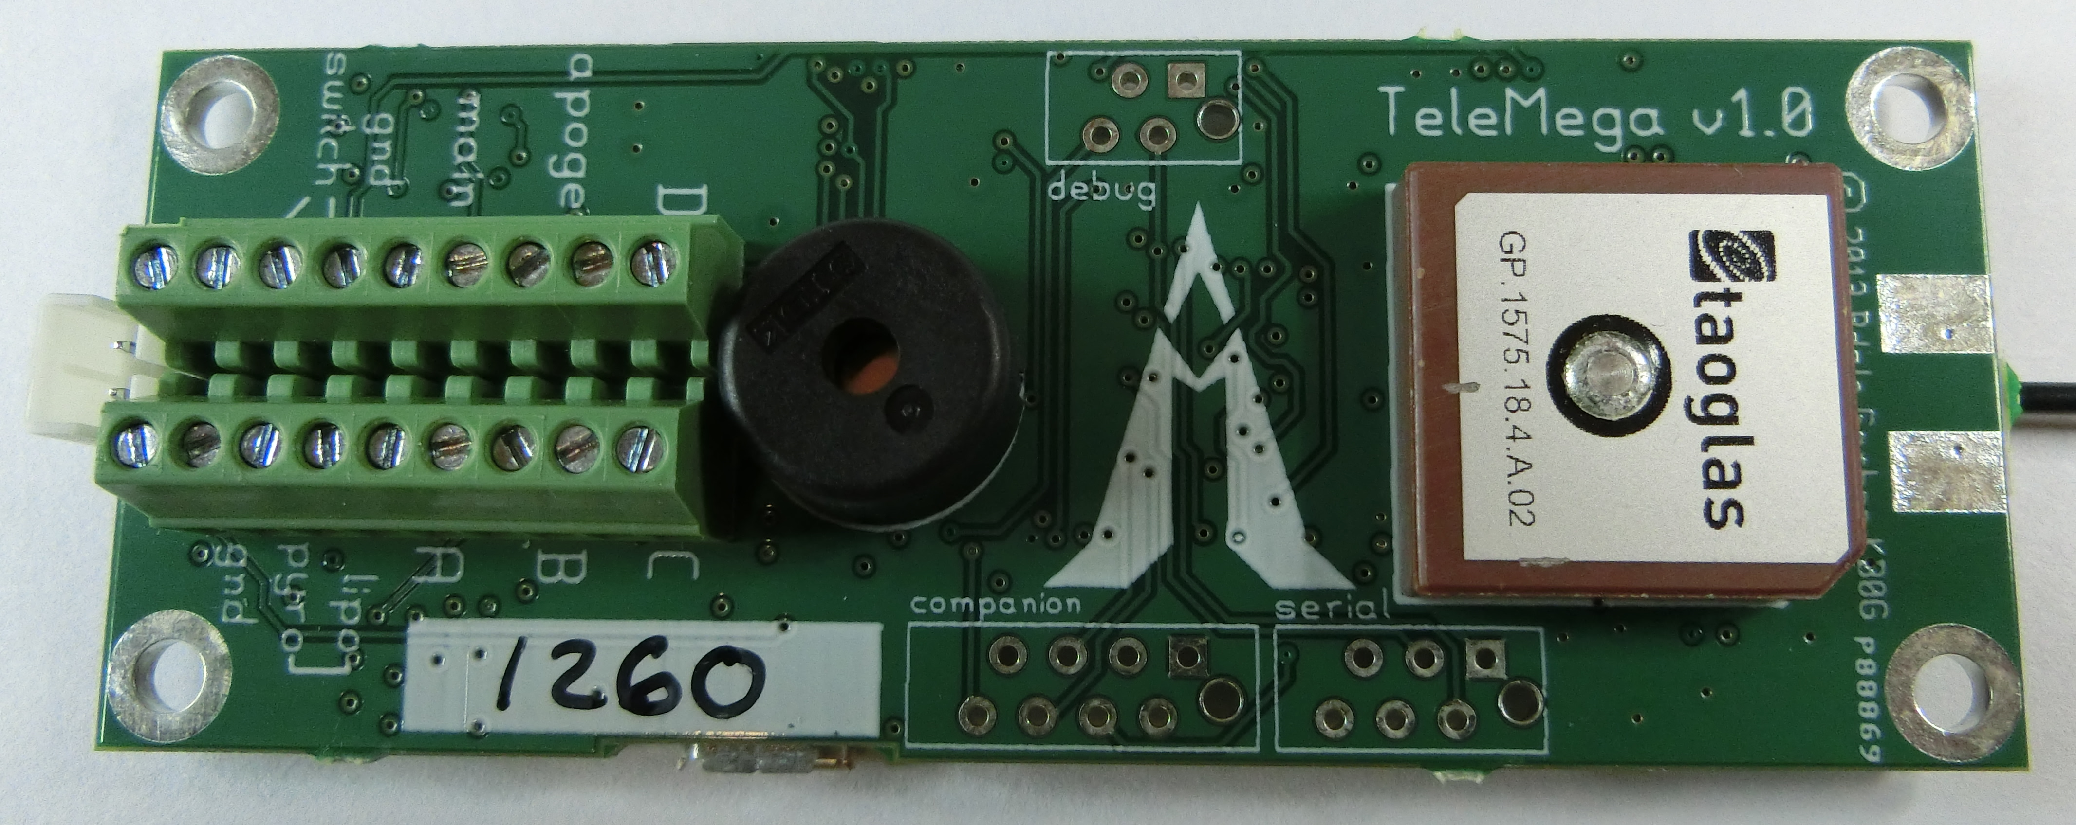
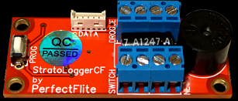
Critical Flight Operations - Recovery
TeleMega Primary Flight Computer
Highly recommended
3.7V LiPo battery as required by manufacturer
Additional 9V pyro battery
6 pyro channels
Newly purchased component - 33% discount
Will not be using telemetry, basis for future teams
TeleMega
StratoLogger CF Redundant Flight Computer
2 pyro channels
18 minute recording time
One 9V standalone battery
20 samples per second
Reused from SRT-2
Stratologger CF
Flight Computers
Electronics & Payload

Slide 20
Critical Flight Operations – Tracking & Recovery
Beeline GPS 17
Beeline GPS
Frequency: 430 MHz
10 mile LOS range
Secured inside fiberglass nosecone
5 second data packet intervals
Standalone system from electronics bay
Received using elevated commercial antenna
Packets decoded with mobile phone app
Reused from SRT-2
Upcoming range test with level 2 rocket
Tracking
Electronics & Payload

Slide 21
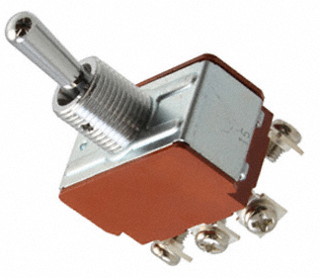
Assembly Process
Entire E&P bay assembled outside of body tube, including battery connections
Toggle switches keep all components powered off
Each flight computer has a separate dedicated switch
DPDT, switching power from the 9V batteries and the built-in switch terminals
All other components under single switch from 12 V battery
Entire E&P bay put into body tube (components off)
After rocket is ready for flight, switches flipped through pressure port holes
Static pressure port area found using rocketry rule of thumb: ¼ inch hole per 100 inch³ , ~4 ½” holes
Assembly
Electronics & Payload

